Slide 1


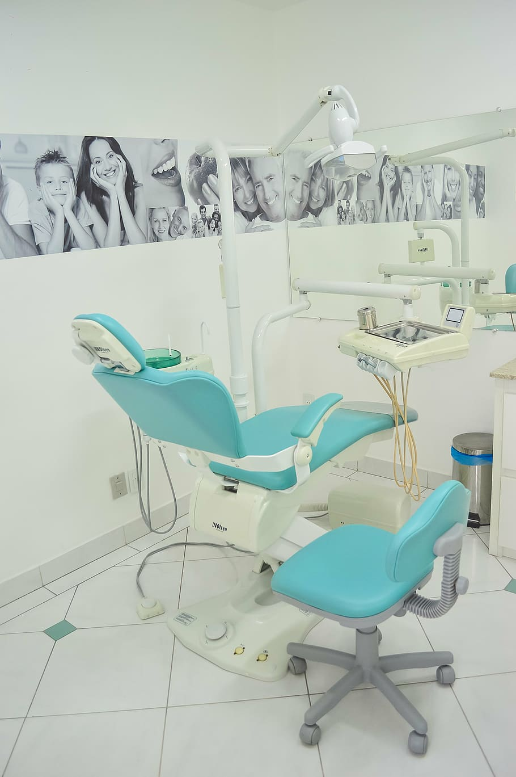
Confirming Compliance with the Dental Amalgam Rule
The City of Terre Haute’s
Dental Office Inspection Program
Notes:
Thank you for inviting me here today to discuss the City of Terre Haute’s dental office inspection program.
We started reaching out to our local dental offices in 2018 with the 1-time compliance report. We wanted to learn who already had amalgam separators installed and who still needed to get into compliance by July of 2020. We also wanted to know what types of separators were out there so we could start learning about how they work.
In August of 2020 we started annual inspections.
Can I get a show of hands? Are any of you conducting inspections? If you are not, that’s ok. You are not required to, but hopefully today’s presentation will encourage you to start taking a look at these facilities.

Slide 2
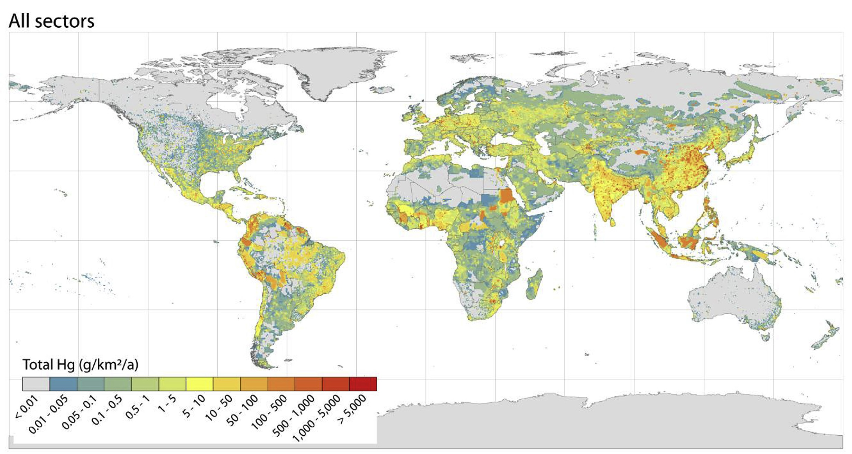
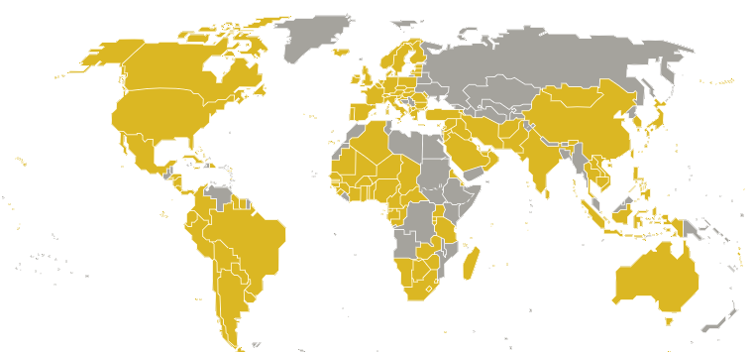
Mercury is a potent neurotoxin that can have a wide range of health effects, and mercury pollution is a global concern.
United Nations Environment Programme Global Mercury Assessment 2018
Notes:
Mercury is in the TOP 10 list of chemicals of major public health concern, according to the World Health Organization. And Mercury pollution is a GLOBAL problem that requires global action because it MOVES with air and water and can be transported THOUSANDS of miles in the atmosphere.
In the United States, we ARE reducing our use and emissions of mercury, but these domestic efforts alone aren’t enough to address the effects of global mercury pollution on the U.S. population.
=The US is 1 of 140 parties that joined the Minamata Convention on Mercury. That is a global treaty to protect human health & the environment from the adverse effects of mercury, adopted in 2013.
According to some estimates, global sources of mercury are accountable for as much as 70 % of the mercury deposited in the United States.
National Research Council. Publication. Global Sources of Local Pollution: An Assessment of Long-Range Transport of Key Air Pollutants to and from the United States.

Slide 3
Sources of Mercury in the environment
Releases from Natural Sources
  Volcanic eruptions
  Weathering of geologic deposits
  Evaporation of ocean water
Releases from Human Activities
  Mining operations
  Coal combustion
  Waste incineration
  Industrial & Commercial uses
Notes:
What are the sources of mercury in the environment?
=We have releases from natural sources and releases from human activities
=Natural sources include volcanic eruptions, weathering of rock, geothermal springs and evaporation ocean water
=Manmade sources include releases during mining operations, coal fired power plants, waste incineration, and other industrial and commercial uses.

Slide 4
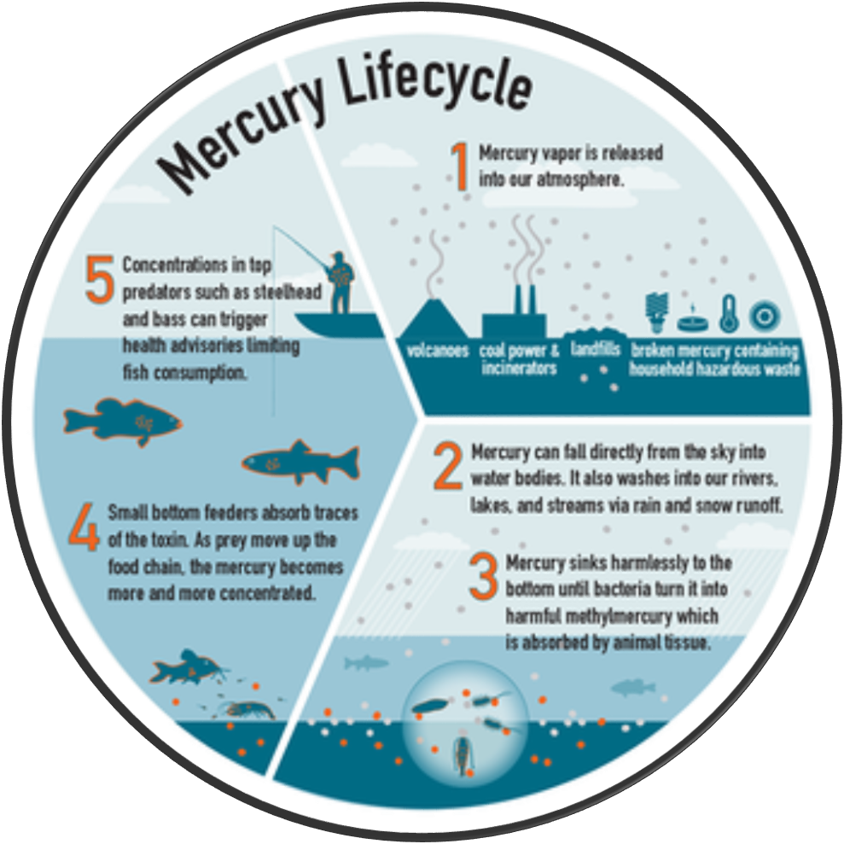
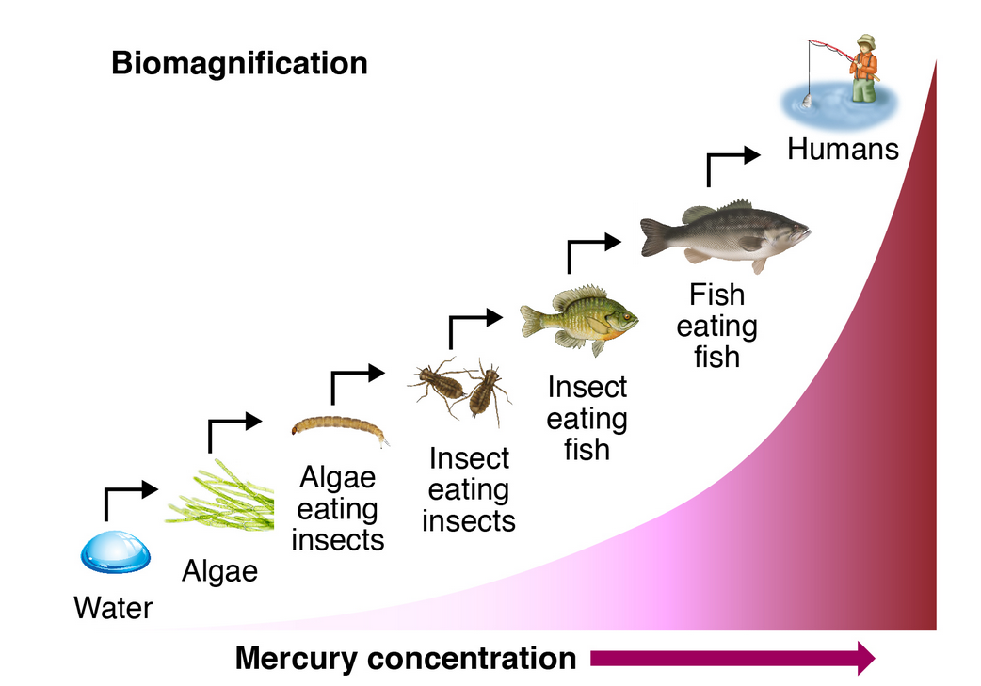
BioMagnification
Mercury is excreted much slower than the rate of intake.
Mercury concentrations progressively increase in the food chain.
Notes:
Mercury released into the atmosphere from all of these different sources falls from the sky and settles in the bottoms of our oceans, rivers, and lakes
Bacteria and microbes process INORGANIC mercury into METHYLMERCURY. And small bottom feeders absorb traces of the toxin
=Since animals ACCUMULATE methylmercury faster than they eliminate it, CONCENTRATIONS INCREASE AT EACH LEVEL OF THE FOOD CHAIN. This process is called biomagnification.
You may find the tissue of a large predatory fish, like a largemouth bass or a northern pike, contains thousands of times more mercury than the water it lives in.
Nearly all methylmercury exposures in the United States occur through eating fish and shellfish that contain higher levels of methylmercury.
Almost every person in the world has at least trace amounts of methylmercury in their bodies.

Slide 5
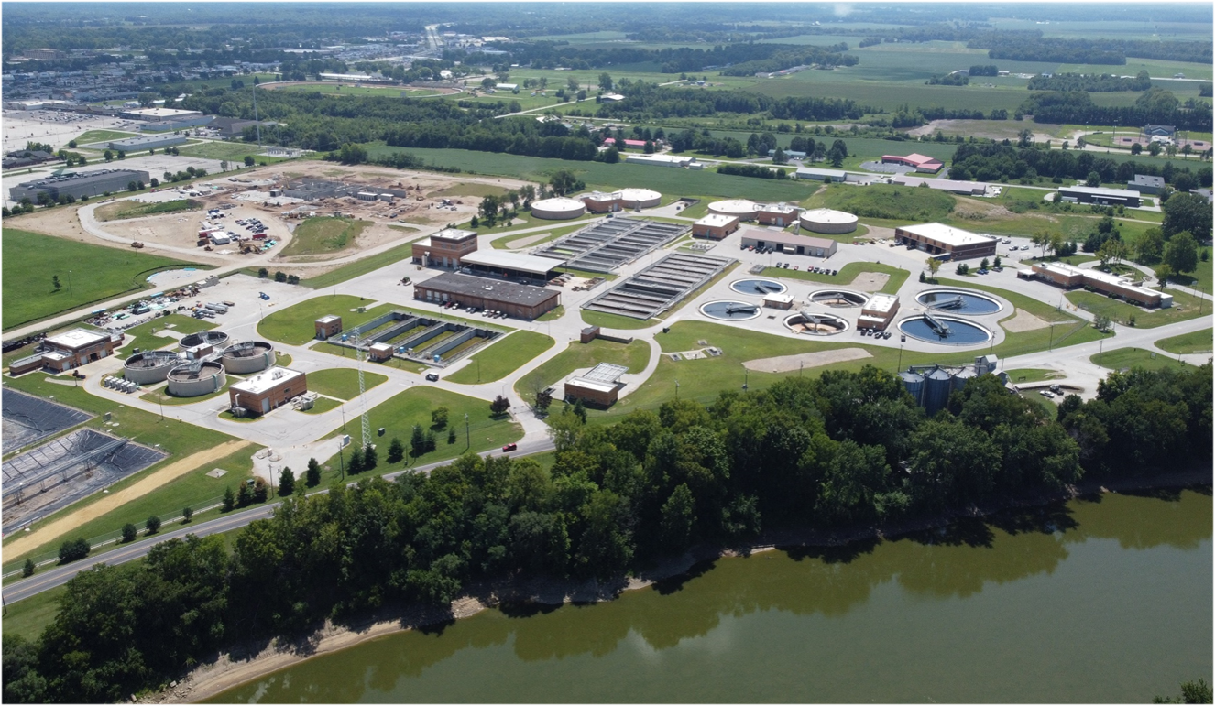
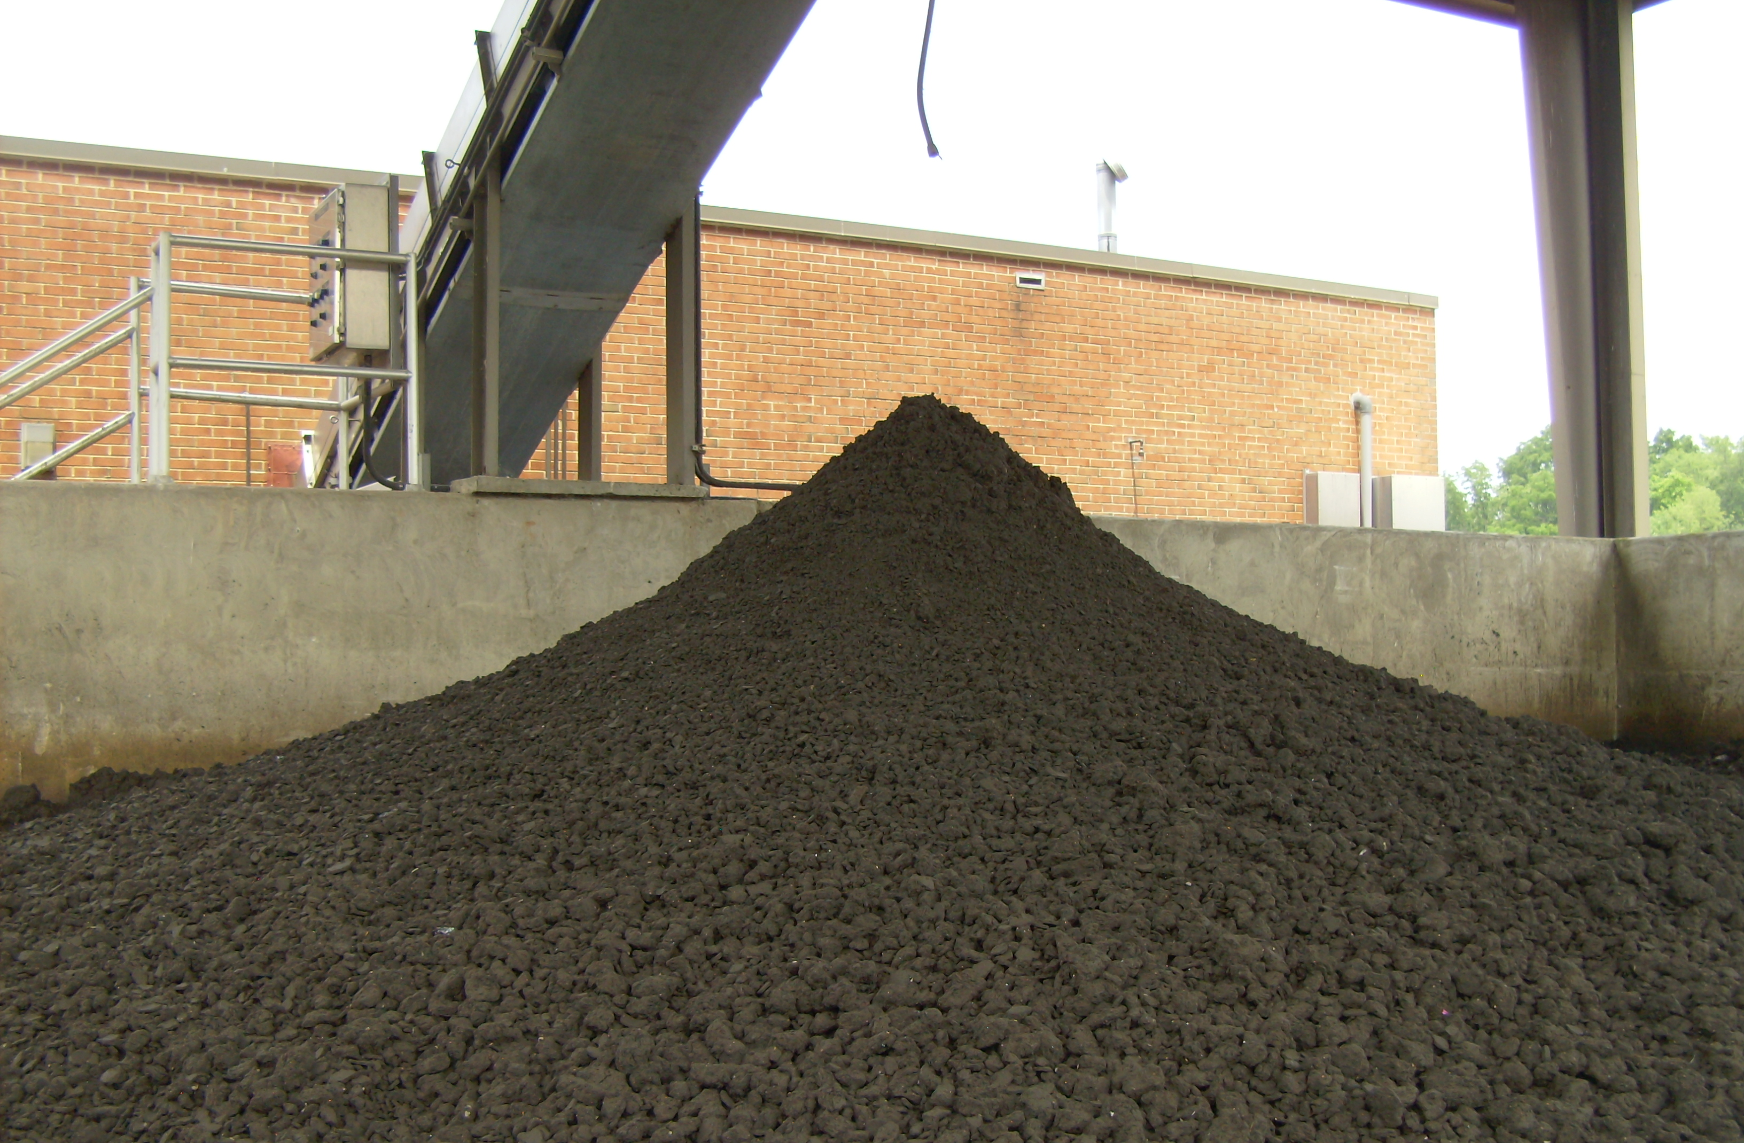
Notes:
When mercury enters our wastewater treatment facilities, it usually settles in the sludge.
=Then we pass that mercury on to the environment through our sludge disposal practices… like incineration, landfilling, or land application.

Slide 6
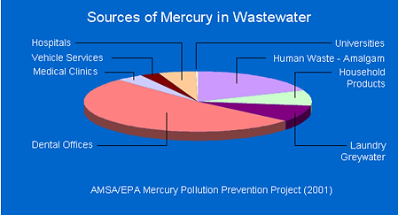
Product | Mercury Content (ppb)
Ajax Powder | 0.17
Comet Cleaner | 0.15
Dove Soap | 0.0027
Soft-cide Soap | 8.1
Ivory Dishwashing Liquid | 0.061
Massachusetts Water Resources Authority/MASCO
Notes:
There are a lot of different sources of mercury in wastewater.
Older vehicles and household products may mercury switches or relays. I can remember playing with mercury from an old thermostat that someone brought to school!
Laundry sources include mold and mildew chemicals washed off of clothing shipped to us from overseas
=I was surprised that trace amounts of mercury can be found in some Cleaning Products
nearly 75% of the mercury is from dental offices and waste amalgam

Slide 7
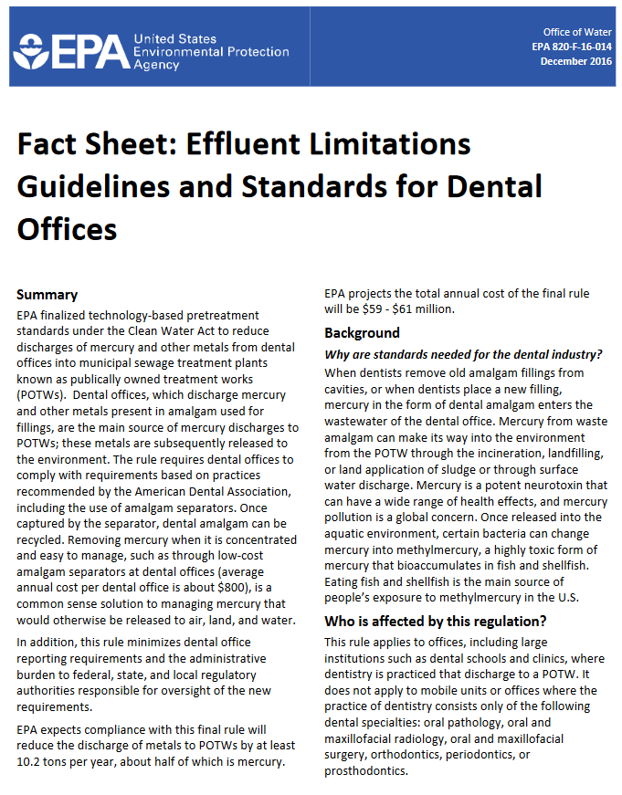


EPA’s Dental Effluent Guidelines
Notes:
The Minamata Convention lists NINE measures for phasing down the use of mercury in dental amalgam. Nations that are part of the Convention are required to implement at least TWO of those nine measures.
In December 2016, US EPA office of Water released this fact sheet for dental offices. It explains that rule requires dental offices to comply with requirements based on practices recommended by the American Dental Association.
Offices placing or removing amalgam must operate and maintain an amalgam separator, must not discharge scrap amalgam, and cant use certain kinds of line cleaners. They must also submit a One-Time Compliance Report.
the States or POTWs are the Control Authorities responsible for oversight associated with the rule.

Slide 8

Compliance Dates
New Practices: Compliance began July 14, 2017
Preexisting Practices: Deadline to comply July 14, 2020
Grandfather Clause
  Practices that have an existing amalgam separator can continue use until June 14, 2027 IF functional
One Time Compliance Report
  October 12, 2020
  90 days after ownership change or 90 days after introduction of wastewater to POTW
Notes:
=New practices must be designed to meet the requirement to control mercury discharges and install amalgam separators from July 14, 2017 on.
=Preexisting facilities that did not have amalgam separators installed needed to update their facilities to meet the requirements by July 14, 2020.
=If they already had a separator installed and it still works properly, they can continue using it until 2027 when needs to be updated.
=One Time Compliance report submitted to the State or the POTW by October 12, 2020 or by 90 days after a change in ownership or within 90 days of starting discharge to the POTW.
=You should periodically compare your list of facilities against the Indiana Professional Licensing Agency’s list of dentists in your county to see if any new compliance reports need to be submitted.

Slide 9

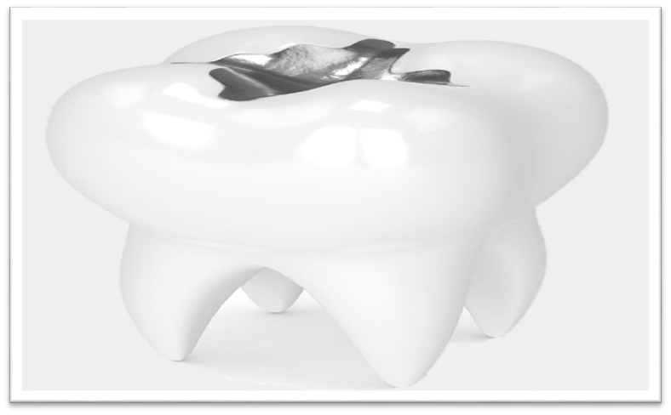
What is dental amalgam?
Sometimes called a “silver-filling”
Low-copper dental amalgam is a mixture of mercury, silver, copper, tin, zinc & other metals
Notes:
What is dental amalgam?
=it’s misleading to call it a “silver filling” because
=a low copper dental amalgam is only 25% silver but it is 50% mercury

Slide 10

Who uses dental amalgam?
185,897 Dental Offices in the US in 2023
80% of these offices use or remove amalgam
Almost all of these facilities send their wastewater to POTWs.
Notes:
This year there are almost 186 thousand dental offices in the US
80% of those facilities place or remove dental amalgam
And most of those places are connected to a POTW

Slide 11
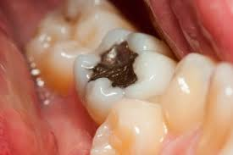
According to the ADA over 100 million Americans have at least 1 mercury amalgam filling
Notes:
If you’re older than 25 and have fillings, like me, they are probably amalgam.
Amalgam fillings are durable and effective, which is why they have been used for well over 100 years.
On average, you can expect a metal filling to last for about 15 years before needing to be replaced.
The length of time can vary based on several factors, such as if you grind or clench your teeth.

Slide 12

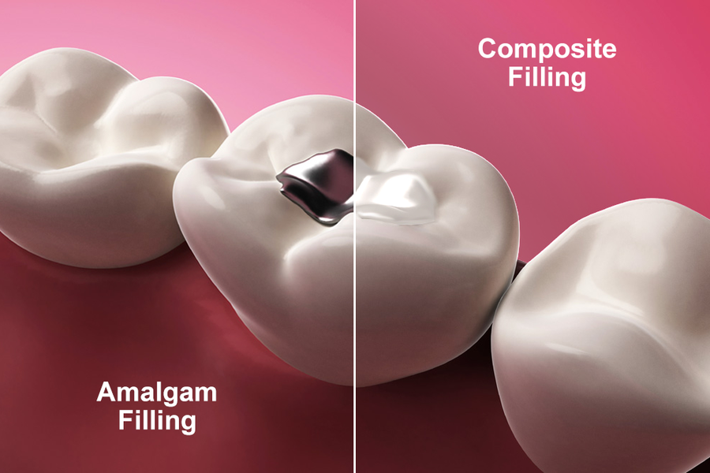


Notes:
If you’re like me, you may have fillings that are nearing 40 years and it’s time to get them repaired.
When these old mercury-containing fillings are drilled out, or new ones are placed, waste amalgam materials flushed into chair-side drains enter the wastewater stream.

Slide 13
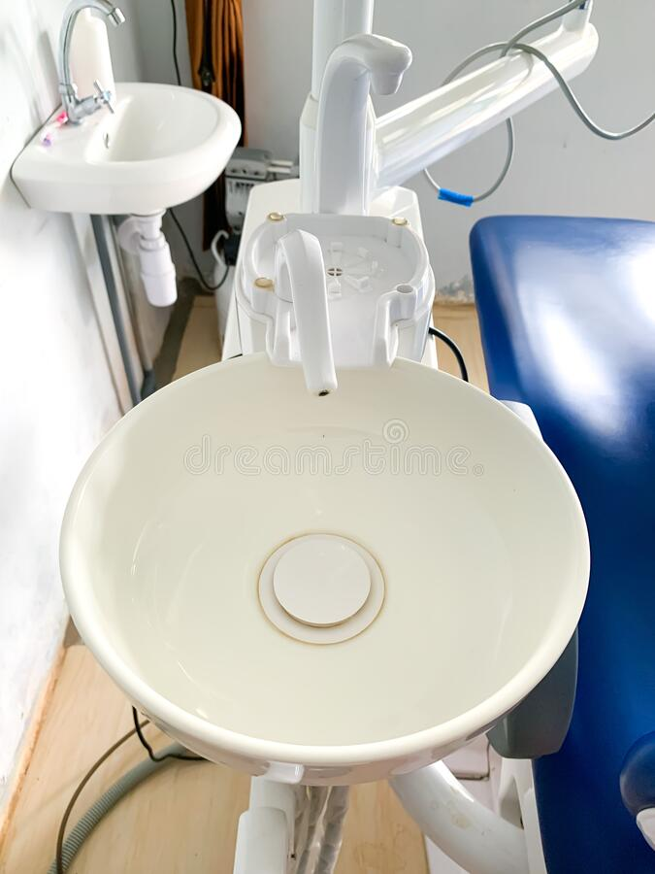
5.1 Tons of Mercury
+
5.3 Tons of Other Metals
Notes:
Dental facilities discharge 5.1 tons of mercury PLUS about 5.3 tons of other metals contained in amalgam

Slide 14

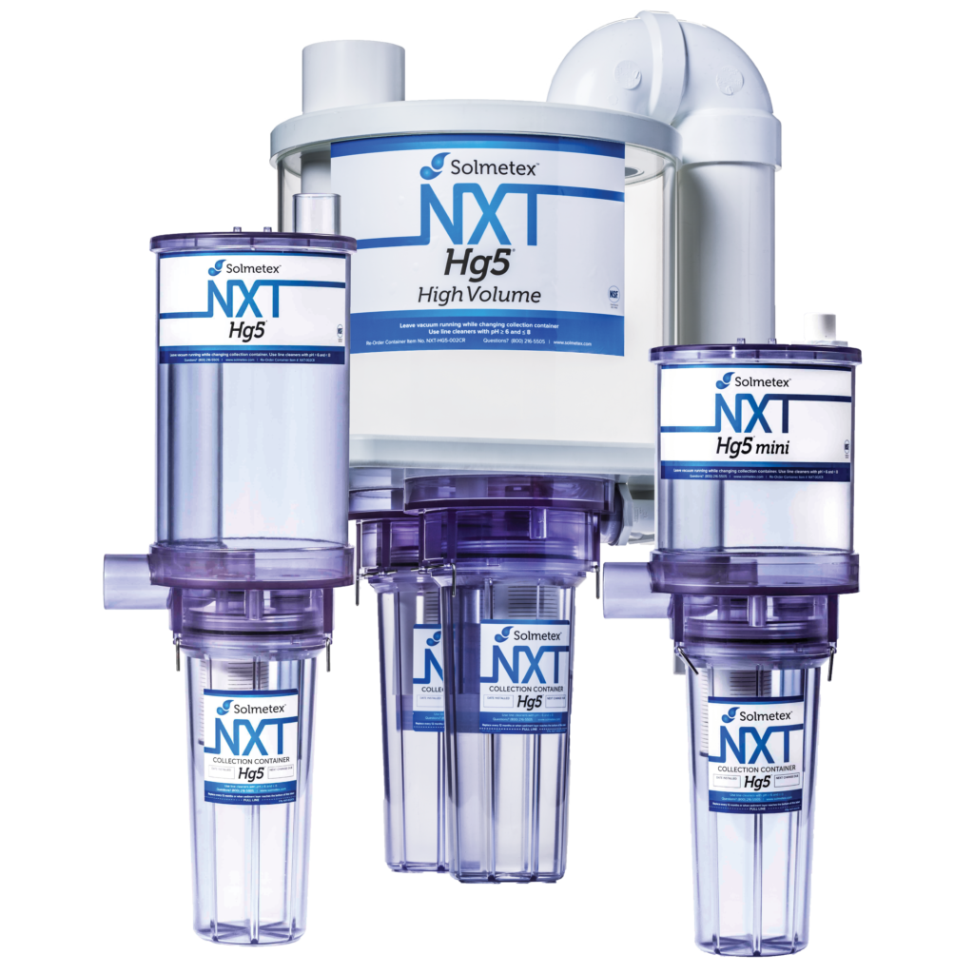
Amalgam separators to the rescue!
Notes:
This is where amalgam separators come in to save the day

Slide 15
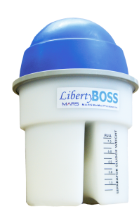
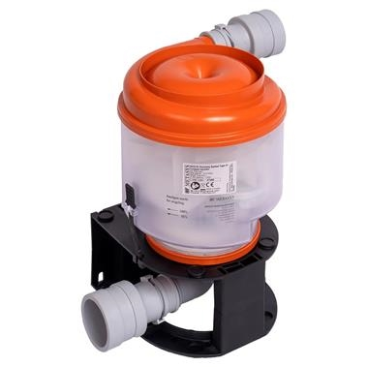
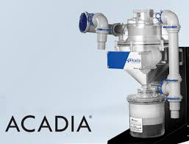
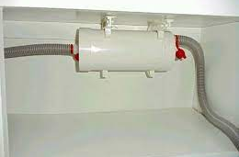
Notes:
There are all different types of separators on the market.
As an inspector, I prefer the clear canisters over the other types.
It easier to see if the device is working properly

Slide 16
Amalgam separator requirements
ANSI/ADA 108-2009 or ISO 11143 approved
95% removal efficiency
Properly sized for maximum flow rate
Documented inspections must be conducted per manufacturer’s O&M manual
Malfunctions must be repaired (or the device replaced) as soon as possible but within 10 business days of detecting a problem
Replace container when amalgam reaches maximum level or per manufacturer’s recommendation in the O&M manual
Notes:
=The EPA requires applicable dental facilities subject to this rule to remove at least 95% of amalgam solids from wastewater with a properly sized amalgam separator or equivalent device that meets the same removal efficiency
=They need to conduct AND DOCUMENT regular visual inspections of the device
=If they find a problem, they have 10 business days to make corrections
=and collection containers must be changed regularly
=you’ll notice that these two items, inspections and replacements, require knowledge of the O&M manual.
As an inspector, you will need to know the requirements for each device. Or….

Slide 17
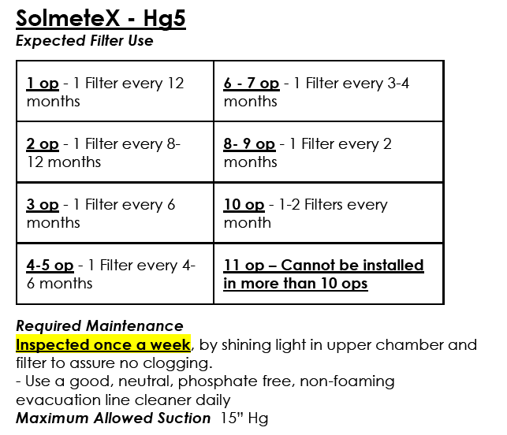
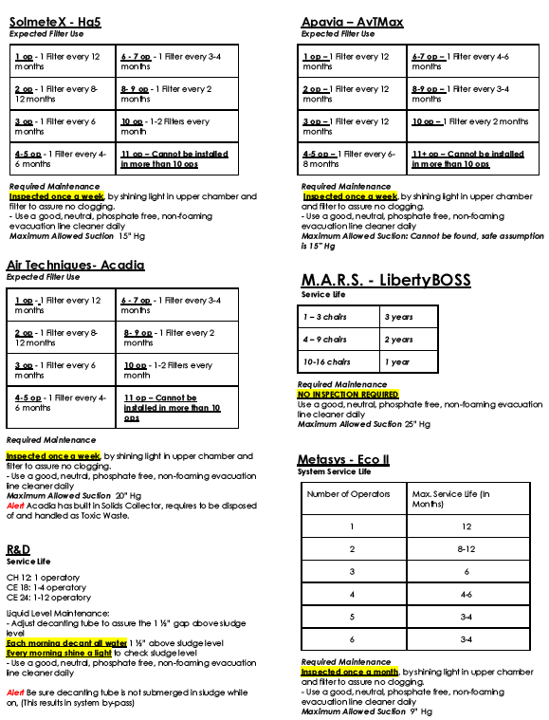
VWEA.org Science Behind Amalgam Separators
Notes:
…You can find a cheat sheet like this.
I found this form, and an inspection form, in a Powerpoint by the Virginia Water Environment Association called the Science_Behind_Amalgam_Separators. It has been very helpful.
=86% of the separators installed in my area were the Solmetex HG5 device. So we will focus on this information today.
This chart is a quick reference guide for information from the O&M manual, like how often each type of separator should be inspected, the expected # of filters a business should likely use per year, and maximum vacuum pressure.

Slide 18
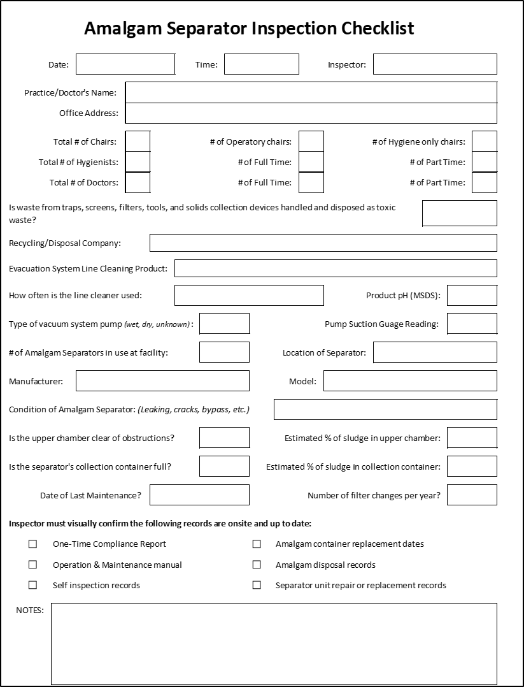
Terrehaute.in.gov
Departments wastewater utility
Dental office compliance program
Notes:
The reference sheet and an easy to use version of the inspection form are both available for download on the Terre Haute Wastewater Utility’s webpage at terrehaute.in.gov
Or you can google ‘Terre Haute Pretreatment’ to find our page

Slide 19
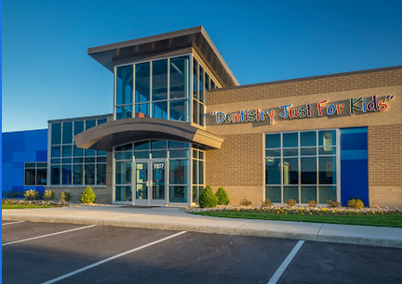
Notes:
When you head out to start inspections you will find some nice new places, like this dentistry just for kids building.

Slide 20
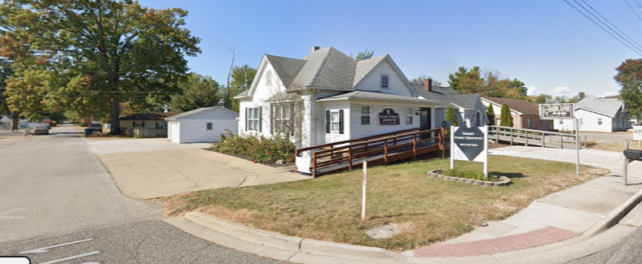
Notes:
Others may be older homes in residential neighborhoods that have been converted into offices

Slide 21
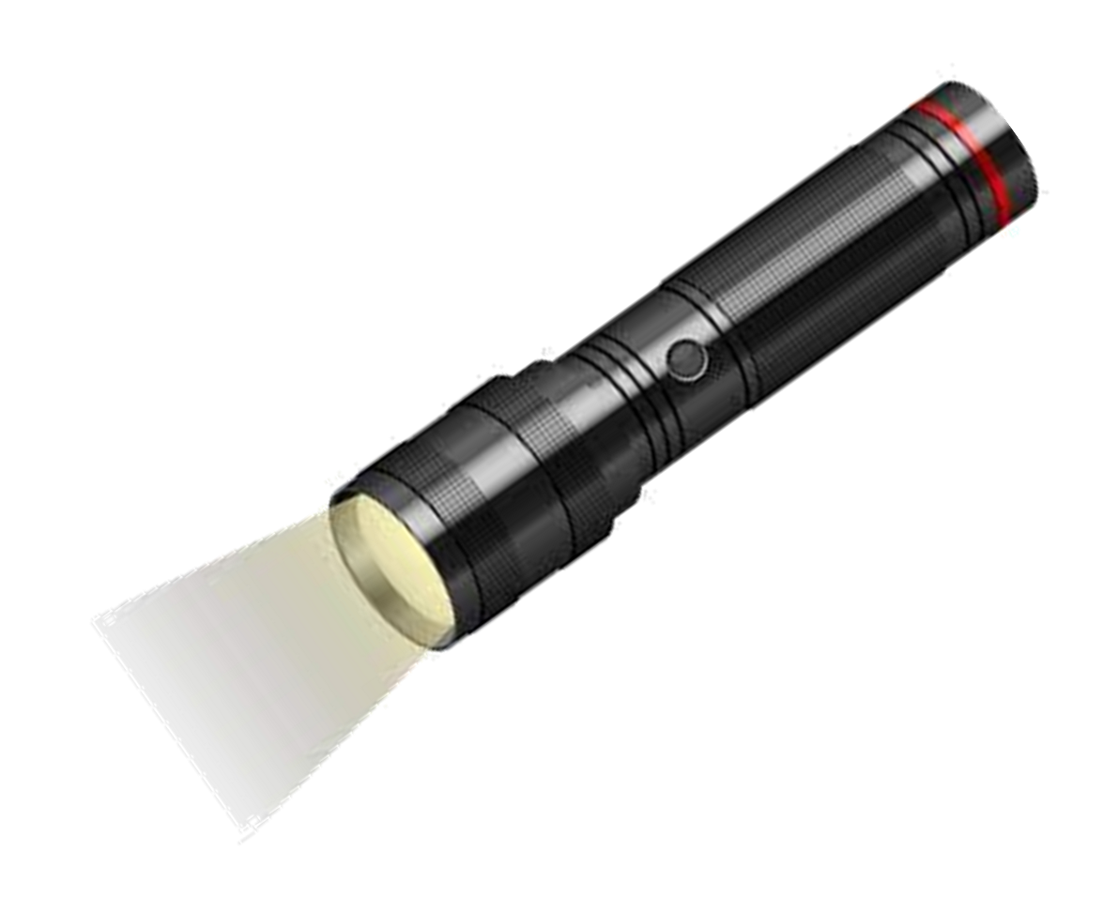
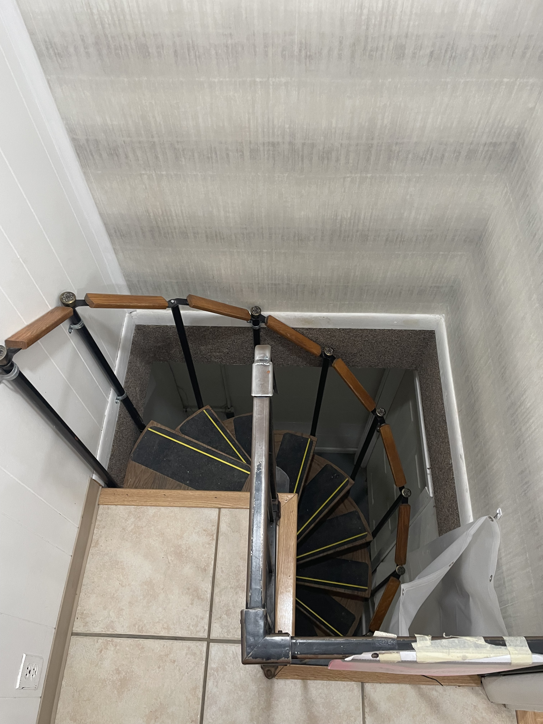
Notes:
Inevitably you will have to face your fears and take some creepy staircase down to a dark basement to inspect someone’s amalgam separator.
Bring your flashlight! You will need it!

Slide 22
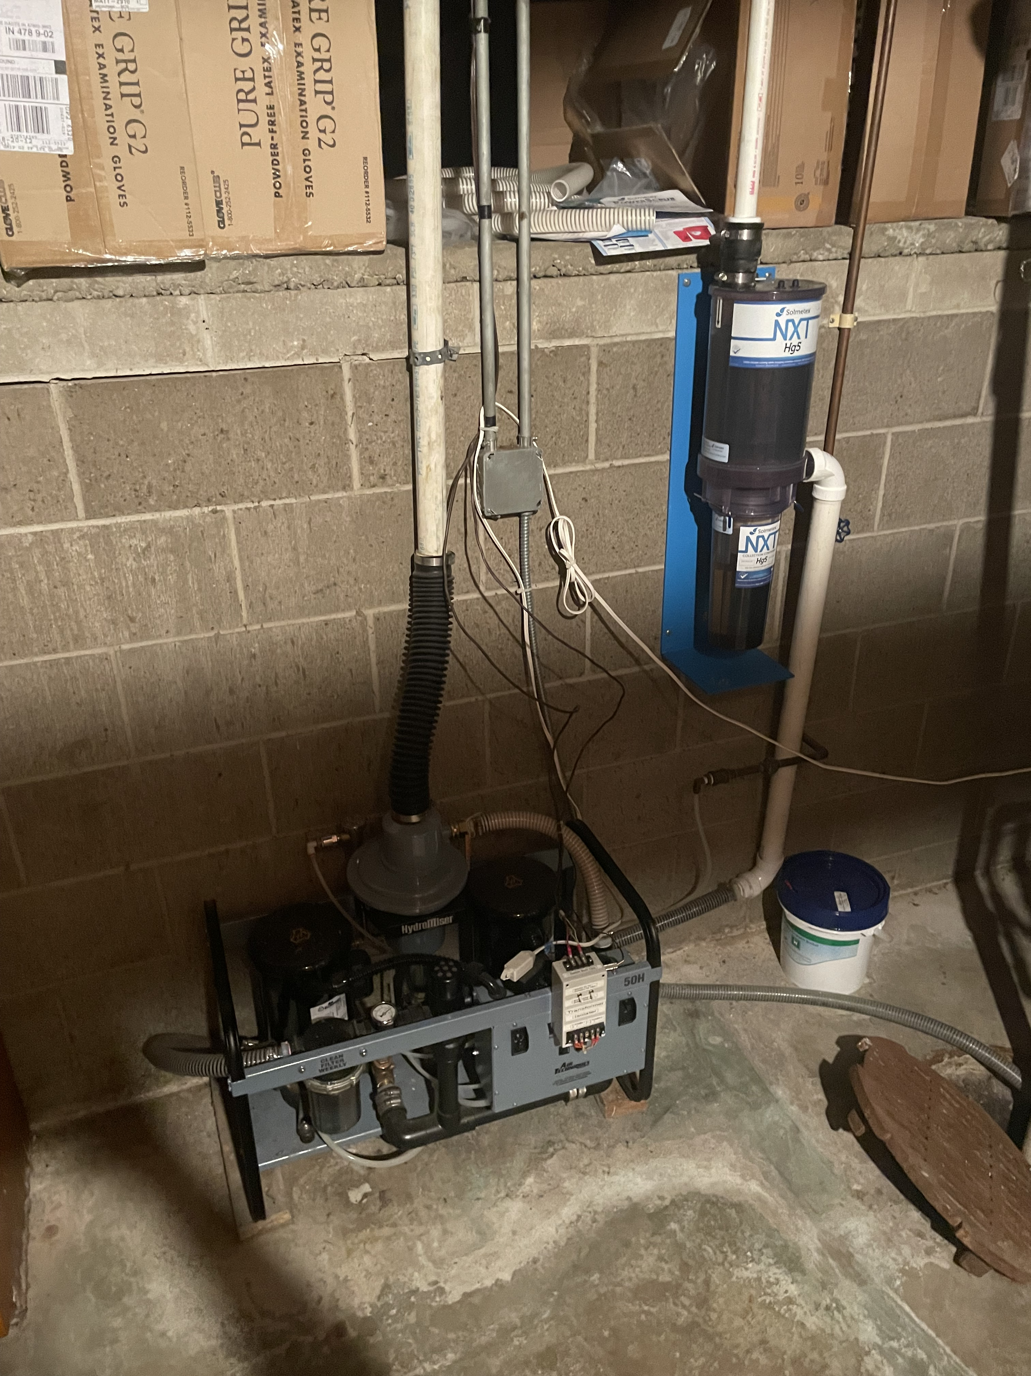
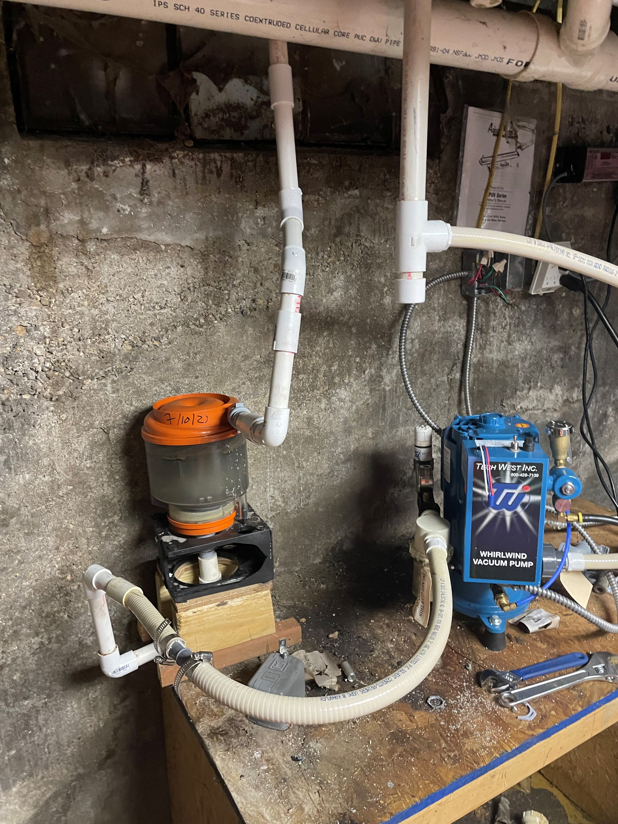
Notes:
Here’s a couple of local examples. You can see that poor lighting can be an issue.

Slide 23
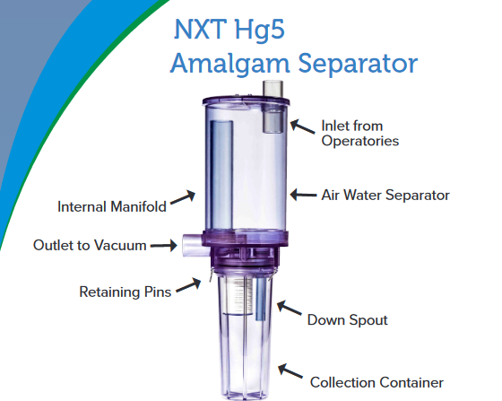
Notes:
Here’s the basic set up.
Dental waste water flows through the vacuum line and enters the air/water separator.
It passes through the down spout where teeth fragments, dental amalgam and mercury are separated and collected.
The filtered water continues to flow through to the vacuum system while heavy waste and sediment is stored in the collection container to be recycled.

Slide 24
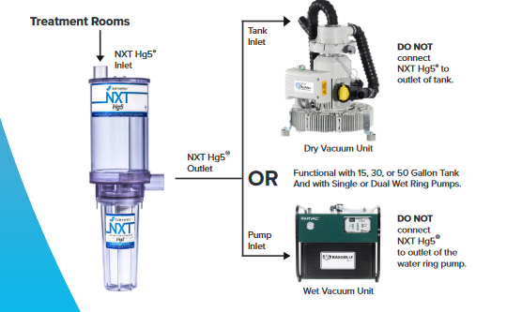
Notes:
These devices can connect to either a dry vacuum unit or a wet vacuum unit

Slide 25
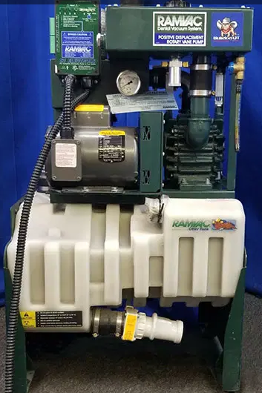
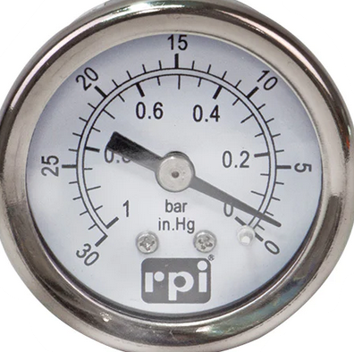
Notes:
This is a wet vacuum unit.
While the vacuum system is running, use will want to use your flashlight to read the gauge.
Then refer to your cheat sheet or the O&M manual for maximum allowable pressure.
The SOLMETEX Hg5 limit is 15.

Slide 26
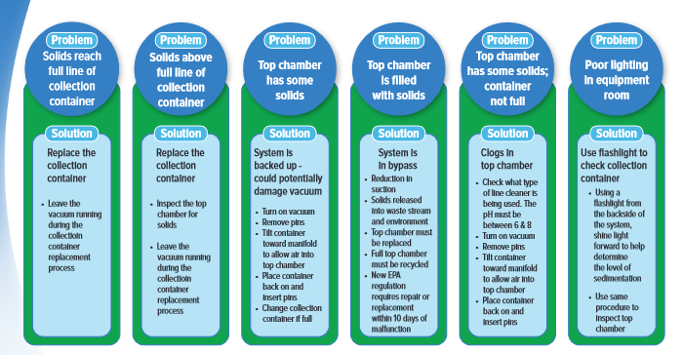
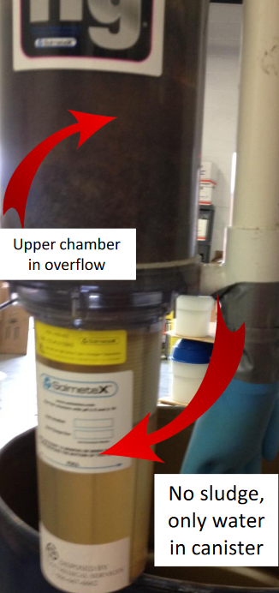
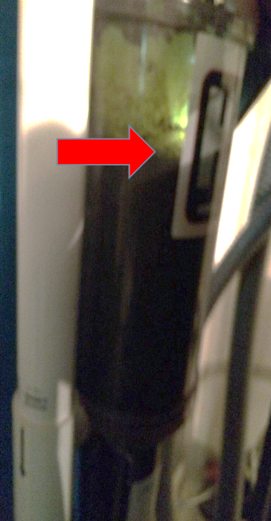
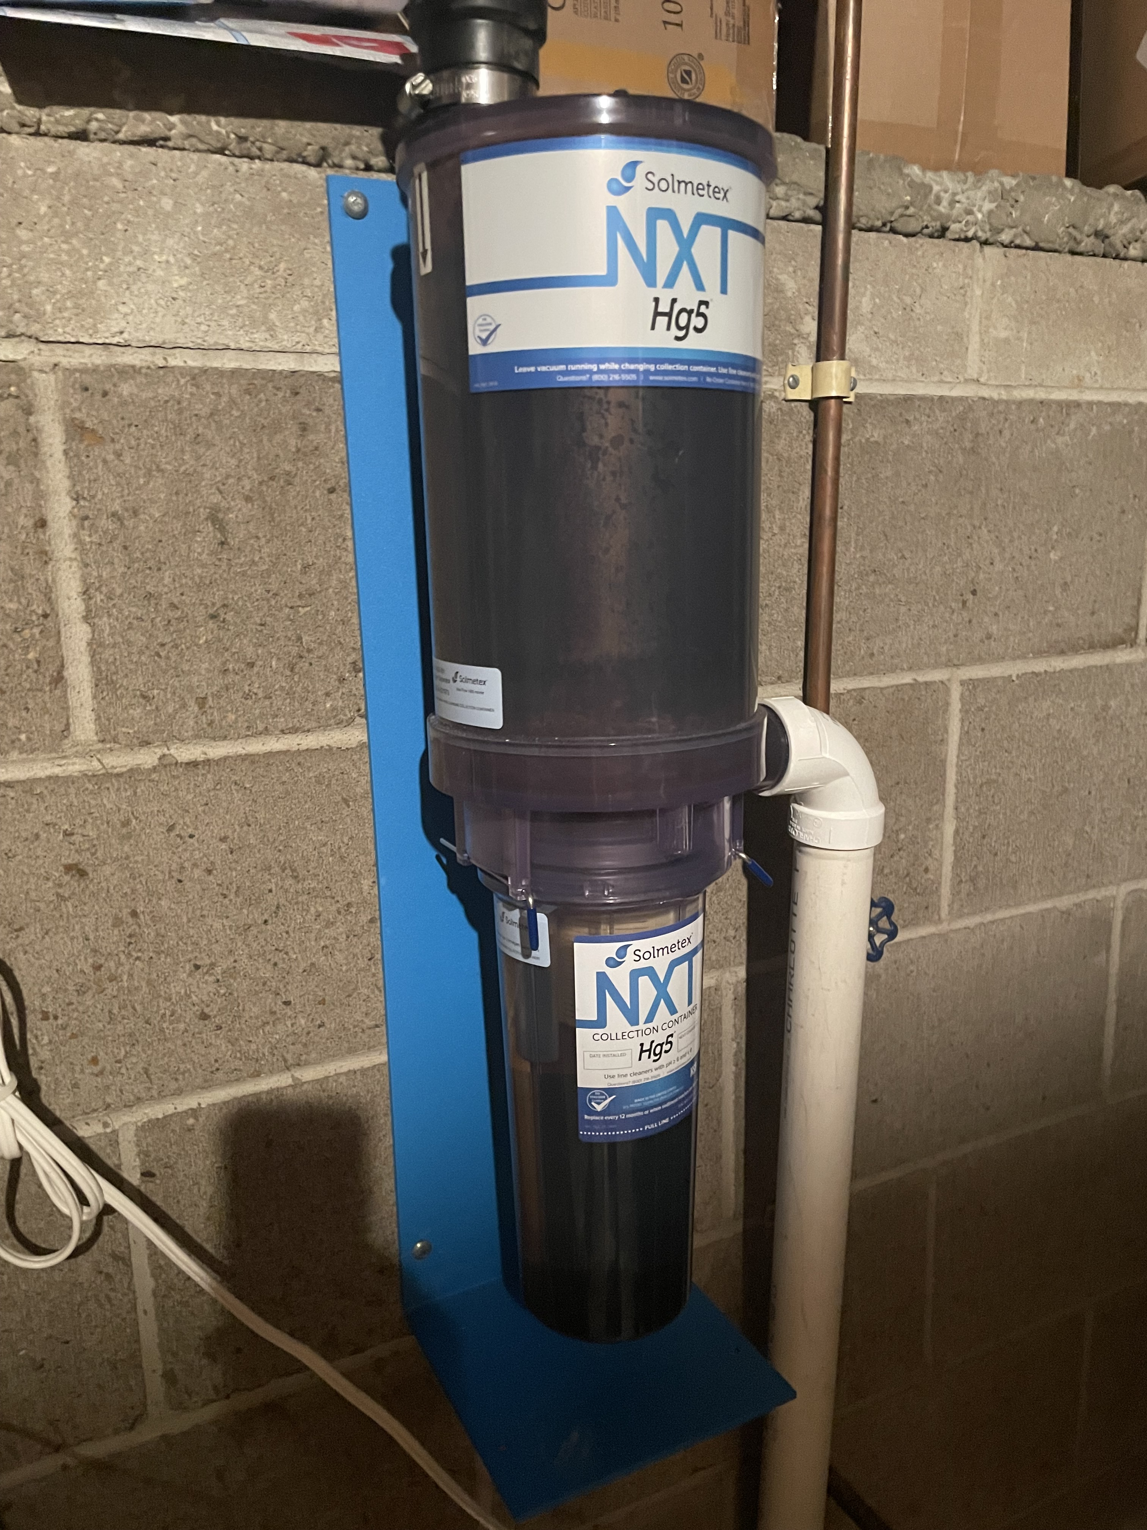
Notes:
Next you will want to take a look at the top chamber. There may be some buildup on the walls, that is not a problem.
=(1) If you see a small layer of solids and water in in the top chamber. The office staff may need to remove the pins and tilt the container to let some air into the system. That usually clears small blockages and fixes the issue.
=(2) If there is a deeper buildup of solids, like more than a few inches, they may be using a line cleaner with a high or low pH. If there is room in the bottom chamber, they can try to let some air into the system and clear the blockage. But they will need to change the line cleaner and will likely need a new bottom filter cartridge.
=(3) this is what a system in bypass looks like. If all of the solids are in the top chamber and the bottom is only water then all of the amalgam wastewater is going straight to the sewer, untreated.
The office would be experiencing reduction in the suction pressure at this point. The full top compartment would need to be replaced within 10 days.

Slide 27
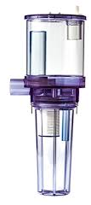

A
BYPASS
IS
OCCURRING
Notes:
Here is a clear image of an amalgam separator.
When the solids buildup in the top chamber
And more water comes into the chamber
The solids overflow through the air vent
And are discharged to the sewer
The bottom chamber may be empty because it was installed incorrectly
Or it may be full of water because there was a blockage that stopped the flow through the system
Or it may be full of solids because no one changed out the filter

Slide 28
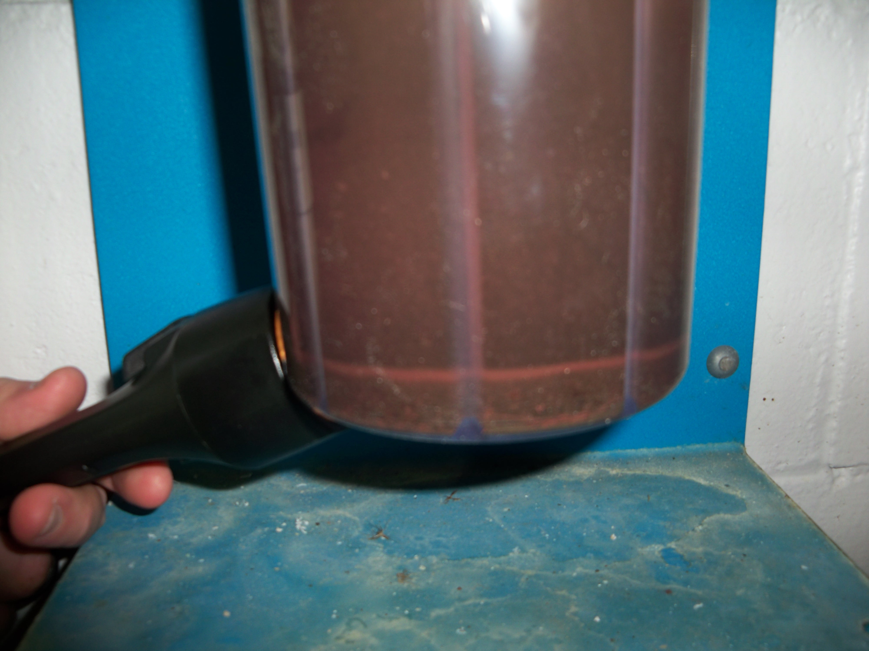
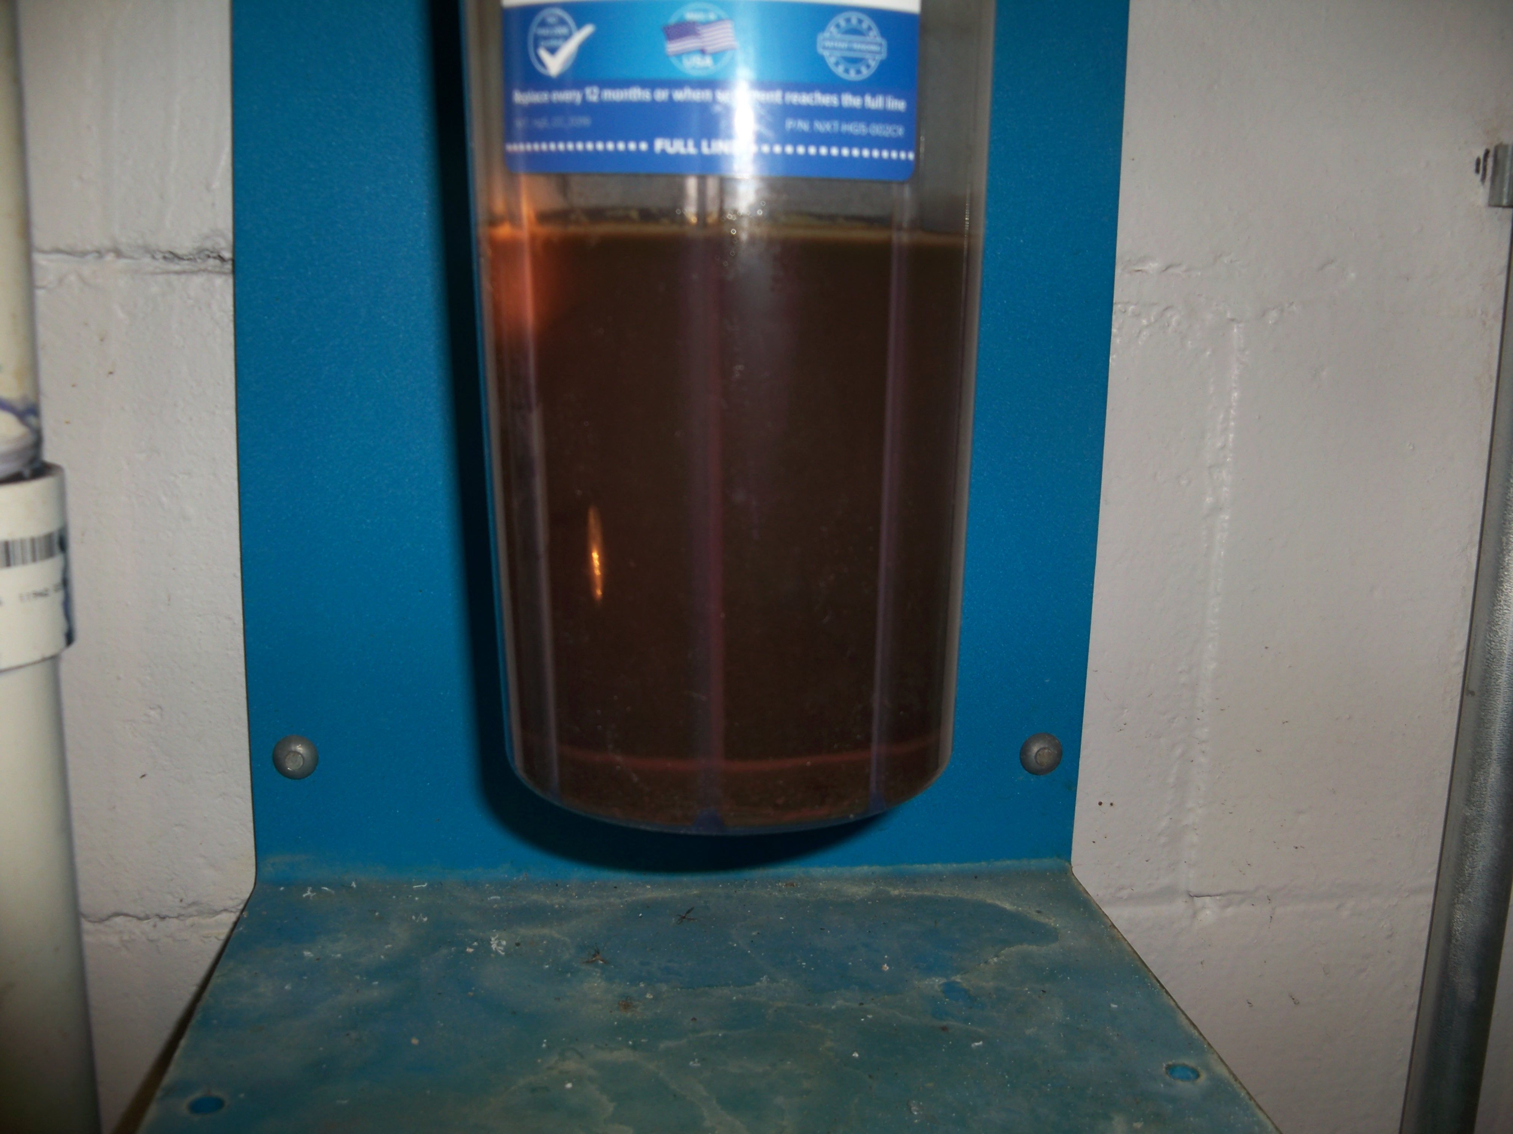
Notes:
Now you want to take a look at the bottom chamber.
=The water can be really cloudy, so you will want to use your flashlight to shine light through the side or the back so you can see how deep the settled material is.
=if the solids are at or above the fill line, the collection container needs to be changed.

Slide 29
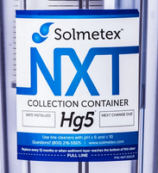
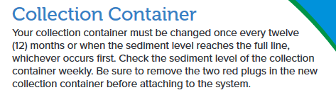
Notes:
The collection containers MUST be replaced according to the O&M schedule.
The office needs to write the installation date on the label.
=we can estimate the next change date based on the # of operatory chairs in the facility.
=but remember…the SOLMETEX unit must be changed when they reach the maximum level OR annually, whichever comes first.
A small office with only one chair may never come close to filling the container in aa year, but to maintain efficiency of the chemically treated resin filter, an annual change is required.

Slide 30
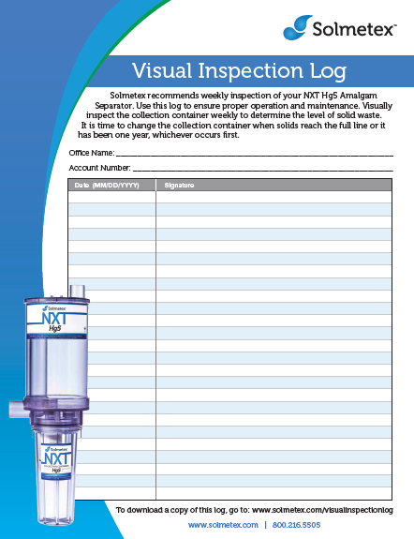
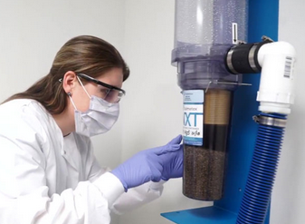
Self Inspections
Solmetex, Apavia and Acadia recommend weekly inspections of their Amalgam Separators.
Metasys Eco II recommends monthly inspections.
Notes:
SOLMETEX, A-pave-e-a and Acadia recommend inspections EVERY WEEK
The Eco II brand only recommends monthly inspections.
Some don’t have any inspections required, just replace annually.
These visual inspections MUST be documented.

Slide 31
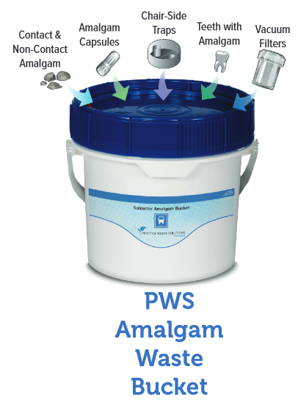
Best management practice requirements
Waste amalgam from chair side traps, screens, vacuum pump filters, dental tools, cuspidors or collection devices are NOT discharged to the POTW
Notes:
The EPA regulations require implementation of 2 BMPs
The first BMP is says Amalgam waste solids like amalgam scrap & capsules or the bits collected in the in-line filters or saliva ejectors can be discharged to the POTW.
We don’t want to find…
…disposable amalgam capsules…or extracted teeth that contain amalgam in biohazard containers, infectious waste containers, sharps containers or in the regular garbage.
All of these materials must be in an amalgam bucket.

Slide 32
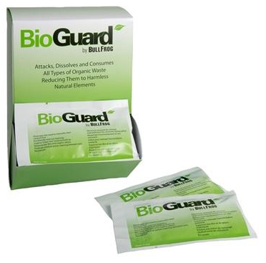
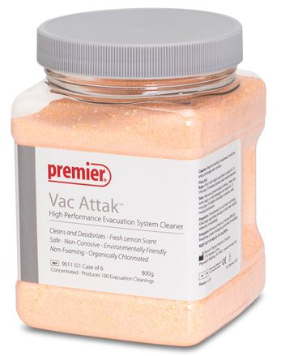
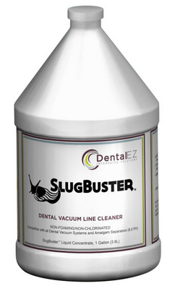
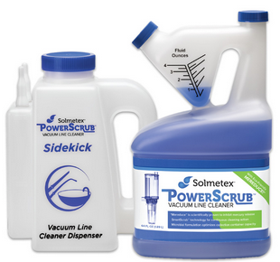
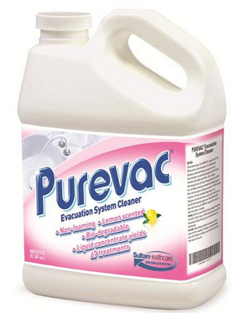
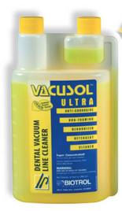
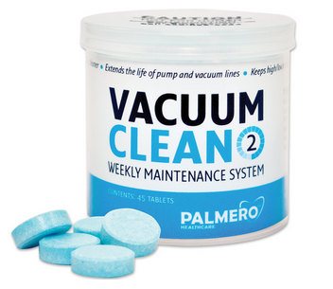
Best management practice requirements
No oxidizing or acidic line cleaners (bleach, chlorine, iodine, peroxide)
No line cleaners with a pH that is < 6.0 or > 8.0
pH 10
pH 12.4
Notes:
The 2nd BMP says No oxidizing or acidic line cleaners (bleach, chlorine, iodine, peroxide)
=And the line cleaners pH must be between 6 & 8
While your inspecting the office, Check bottle for pH level or you can search for the online SDS with your phone.
Label may say “Safe, non-corrosive, environmentally friendly” like this VacAttack product, but the pH is 10.0 and it cannot be used.

Slide 33

Notes:
Ask how often the line cleaner is used.
The SOLMETEX device says rinse no more that 5 chairs every 10 minutes to avoid overfilling the separator.
Overfilling = bypass

Slide 34


Documentation Requirements
One Time Compliance Report onsite (physical or electronic) for as long as the facility is in operation or until ownership is transferred
Manufacturer’s operation and maintenance manual for the current device (physical or electronic)
Notes:
The EPA rule requires several forms of documentation to be onsite.
The facility should have a copy of the 1 time compliance report and the O&M manual available in physical or electronic form

Slide 35
Documentation Requirements
The following records must be kept for 3 years:
Date, name of person and results of each inspection of the amalgam separator, plus any follow up inspections or corrective actions
Documentation of amalgam separator container replacements (dates)
Documentation of all dates that collected dental amalgam was picked up or shipped for proper disposal per 40 CFR 261.5 (g)(3), and name of the permitted or licensed treatment, storage or disposal facility receiving the amalgam retaining containers
Documentation of repair or replacement of an amalgam separator including date, name of person, description of repair or replacement, including make and model numbers
Notes:
The Rule says these records need to be kept for 3 years:
=they need to keep copies of their self inspection forms, I would also add copies of POTW inspections to that.
=proof of canister replacements throughout the years, minimum of 1x/year, but larger facilities may have multiple replacements each year.
=proof of proper disposal of amalgam waste, solids bucket and full filter canisters
=any documentation of separator repair/replacement

Slide 36

Notes:
When we started inspections in 2020 documentation was not organized. We provided a summary of what was required and suggested the facilities keep everything together in a binder to make future inspections go more smoothly.

Slide 37





All practice documentation available 24/7/365
Certificates of Recycling & History
Certificates of Installation
Certificates of Warranty
Access to Solmetex Compliance Program
Print recycling shipping label
Notes:
Some companies, like Solmetex, have an all-in-one compliance program that keeps digital copies of records for the facility and automatically ships filters, line cleaners and recycling buckets to dental users.
Staff at the dental office are still responsible for conducting their own inspections and keeping that documentation up to date at the facility.

Slide 38



The inspections
2020
2021
2022
Notes:
The goals of our initial round of inspections in 2020 were to learn about implemented practices, provide information and recommendations, and assist with compliance.
=in 2020 the Office staff looked like this. Our unannounced visits helped us identify technical issues that needed to be addressed by equipment suppliers, inspection and recordkeeping deficiencies, and several minor and major Rule violations.
=Here is the face of 2021. Facilities were notified by mail that inspections would start the following week and we provided a list all of the documentation that we would want to look at, like the O&M book, inspection records, recycling records, etc. Some were prepared, some were not.
=The 3rd round of inspections in 2022 were scheduled. Many offices knew what to expect and had materials in binders. They were ready and waiting for us to arrive and proud to show what they had achieved.

Slide 39
Success is on the rise!
Notes:
This chart shows FAILED inspections in Blue and PASSED inspections in Green
The first year, 2020, all 31 facilities inspected failed to meet one (or several) of the Rule requirements. I even found One facility that had signed the 1 time compliance report, certifying that an amalgam separator was installed, but I found the device in it’s original box buried in a storage room.
The 2nd year, we were almost 50/50, with 16 failing and 13 passing
Last year the tables turned and we had 79% of the facilities in compliance

Slide 40
Typical Issues discovered
Notes:
This chart shows the typical issues that caused facilities to fail an inspection.
The brown color in the back is representing facilities with no documentation on site. We started with 18 and ended up with only 3 that need to keep better records which is a good achievement because this program is so document heavy.
The middle green bars represent self inspections that weren’t being conducted or documented. You can see we started with 19 facilities in noncompliance and ended up with just 2 that still have work to do.
Finally the blue bars are operational failures, like using the wrong pH line cleaner, failing to change full filters, or continuing to operate a device that was in bypass. Initially we found 13 facilities fell into this category in 2020 and last year we only had one.

Slide 41

Notes:
That facility was using a high pH line cleaner. The top chamber was 80% full and the bottom canister was empty.
The system was bypassing. And inspection records were out of date.
All of our facilities receive a copy of their inspection report, like this one. Any corrective action is clearly stated and follow-up is required.

Slide 42


Contact Us
Alicia.barnard@terrehaute.in.gov
Notes:
We believe that working together with our dental facilities and conducting these in-person site visits has been a worthwhile way to help these offices build a good foundation to meet the requirements of the Dental Amalgam Rule.
The compliance records continue to improve and the dental staff want to exceed the expectations of our state and federal regulators.
I am happy that Our Pretreatment Department is here to help make that happen.

